Slide 1
5 Grammatical relations and alignment
ENG 452: Linguistic Typology
Slide 55

Slide 2
5.0 Introduction: Grammatical relations and alignment
Grammatical relations refer to the structural relationships between different elements within a clause, like subject, object, and indirect object.
It is about the basic relations include subject (S), direct object (DO), and indirect object (IO)
which is identified through features like case marking, word order, and verb agreement.

Slide 3
while alignment typology is a way of classifying languages based on how they mark the grammatical relations of participants (arguments) in a sentence, particularly the subject of an intransitive verb and the subject and object of a transitive verb, using case markings or other morphological features; essentially, it describes how a language aligns its grammatical roles across different sentence types.
To determine a language’s alignment type, linguists examine how the grammatical relations (S, A, O) are marked morphologically in different clause structures.
Alignment typology helps compare and contrast languages based on their grammatical structure.
Can provide insights into the evolution of languages and potential influences on grammatical development.

Slide 4
We will look at:
Grammatical relations
Alignment typology – Case marking system in languages
Case and agreement system

Slide 5
5.1 Marking of Grammatical Relations
Case marking, agreement, and constituent order can all function at the clause level to indicate the relationship that a noun phrase bears to a verb.
In Morphological Typology (our Lecture PPT 3), we have seen
the use of case affixes to mark verbal arguments was labeled as a type of dependent marking,
whereas the use of agreement affixes on the verb was identified as the parallel head-marking device,
and the use of constituent order was an example of no marking (i.e., neither the head verb nor the nominal dependents were morphologically marked to reflect their syntactic association).
(we will repeat those examples below, 4 slides from Morphological Typology, Lecture PPT 3)

Slide 6
Government
In the following ancient Greek data, the choice of which case suffix is used on a noun is determined by the preposition (which is in bold type):
(1) a. ana skē:ptr-ō: (DAT) “upon a staff”
b. apo tou hipp-ou (GEN) “from a horse”
c. en Spart-ē (DAT) “in Sparta”
d. eis basil-ea (ACC) “to the king”
Notice that the prepositions carry no special morphology. They are monomorphemic and fixed in form regardless of the noun that follows them. This is a classic case of government, in which the syntactic relationship between two constituents is captured by obligatory marking on the dependent constituent.
the preposition is said to “govern” a particular case—for example, ana (“up”) governs dative case

Slide 7
Agreement
A different situation arises in the Spanish (Italic: Latin America and Spain) data in the following:
(2) a. la elefanta negr-a “the black female elephant”
b. las elefantas negr-as “the black female elephants”
c. el gato negr-o “the black male cat”
d. los gatos negr-os “the black male cats”
Unlike (1), the syntactically dependent constituents in (2) are placed in a form that corresponds to that of the head noun so that all three are in agreement.
In (2a), the noun elefanta ("elephant") is feminine singular.
Consequently, the feminine singular article la must be used, and the adjective must be formed with
the feminine singular suffix -a.
Spanish has grammatical gender, meaning the word changes depending on whether you are referring to a male or female
Masculine form: "El elefante" (the male elephant).
Feminine form: "La elefanta" (the female elephant).
Male cat ("gato") or a female cat ("gata").

Slide 8
The notions of government and agreement are used in describing the nature of the morphological connection between constituents.
If the morphological marking of a dependent is determined by a head, but does not reflect any semantic or grammatical features of the head, it is considered government (as in the Greek example in (1) above).
If the morphological marking does reflect such properties, it is a case of agreement (as in the Spanish example in (2) above).

Slide 9
The syntactic relation that holds between head and nonhead in these constructions is not always indicated morphologically.
In Kobon (Trans-New Guinea: New Guinea), simply juxtaposing possessor and possessee (3) can create genitive constructions that are semantically comparable to the English and Hungarian discussed previously.
(3) Dumnab ram
Dumnab house
‘Dumnab’s house’

Slide 10
Indeed, it is most likely true that all natural languages use at least one of these relation-marking strategies to identify the nominals that have unique grammatical relations (such as subject and object) or unique semantic relations (such as agent and patient) or both.

Slide 11
Despite their universality in argument structures (Subject, Direct Object, Indirect Object), languages display considerable diversity in their overt expression of these structures.
Languages employ different strategies in order to distinguish certain arguments from each other.

Slide 12
One logical option for languages to mark their arguments is the use of word order.
Languages with a fixed word order can reserve sentence positions for different arguments (Sinnemaki, 2010).
This works especially well for SVO languages as well as those few languages of OVS but very rare.
Languages with other basic word orders can of course still employ word order to mark their arguments, as long as they are rigid in their basic order. In these languages, however, it might become problematic when one of the arguments is not overtly expressed, for instance when topic drop occurs.

Slide 13
Another effective strategy for languages to distinguish their arguments is marking.
Many languages encode information such as person, number and gender about either the subject, the object or both on verb inflection, so-called head marking.
Another form of marking is dependent marking, where arguments are assigned case markers that encode their grammatical function (Nichols, 1986). [we have seen examples above]
This latter strategy is quite effective, because these case markers are usually very easy to distinguish.

Slide 14
One of the major functions of the basic word order at that level is to indicate
‘who is doing X to whom’. = ‘who is doing WHAT to whom’.

Slide 15
This can easily be demonstrated by comparing the following two English sentences.
(1) The girl kicked the boy.
NP V NP
(2) The boy kicked the girl.
NP V NP
Note that the roles of the NPs the girl, and the boy in (1) are different from those of the same NPs in (2) despite the fact that these two sentences contain exactly the same (number of) words and constituents.
By roles is meant the relationship that holds between the NPs and the verb, and also between the NPs themselves.
In (1) the girl is the 'kicker' and the boy is the 'kickee’.
In (2) the roles of these NPs are reversed, with the boy being the 'kicker' and the girl being the 'kickee’.
This difference in the roles of the NPs in the English sentences in (1) and (2) is, of course, signalled directly by the difference in the relative positioning of the NPs.
Notes:
Note that the roles of the NPs the girl, and the boy in (1) are different from those of the same NPs in (2) despite the fact that these two sentences contain exactly the same (number of) words and constituents.
By roles is meant the relationship that holds between the NPs and the verb, and also between the NPs themselves.
In (1) the girl is the 'kicker' and the boy is the 'kickee’.
In (2) the roles of these NPs are reversed, with the boy being the 'kicker' and the girl being the 'kickee’.
This difference in the roles of the NPs in the English sentences in (1) and (2) is, of course, signalled directly by the difference in the relative positioning of the NPs.

Slide 16
In languages such as English the clausal basic word order is relatively fixed (hence English as a fixed word order language) and exploited to a great extent for the purpose of indicating ‘who is doing X to whom’.
In many other languages, however, there are other grammatical or formal mechanisms in use for marking such roles as reflected in (1) and (2).
These mechanisms may involve morphological forms (e.g. affixes) or function words (e.g. adpositions) which express the semantic roles or grammatical relations of the NPs in the clause.
This type of explicit marking is referred to broadly as case marking in the literature.
Nichols (1986) offers a typological parameter that is useful for discussion of case marking: head marking vs. dependent marking

Slide 17
Morphological marking of semantic roles or grammatical relations may appear directly on the head or on the dependent of the constituent (or even on both).
At the clausal level the predicate or the verb is the head, whereas the argument(s) is (are) the dependent(s).
If the marking of 'who is doing X to whom' is represented on the verb, it will be called head marking.
If, on the other hand, the marking is borne by the dependent (i.e. the argument NP), it is known as dependent marking.

Slide 18
Languages such as Tzutujil are characterized as exhibiting head marking since case marking appears directly on the verb (Dayley 1985: 417).
(3) Tzutujil
x-Ø-kee-tij tzyaq ch'ooyaa
ASP-3SG-3PL-ate clothes rats
‘Rats ate the clothes.’
Note that the prefixes on the head of the clause or the verb, i.e. -Ø- and –kee in (3) represent the grammatical or semantic relations between the verb and the full NPs by registering the person and number properties of those NPs.

Slide 19
Hindi can be considered an example of a head-marking language because it exhibits the characteristic of marking grammatical agreement primarily on the verb (the head of the clause), which changes its form to reflect the person and number of the subject and sometimes the object, rather than marking these features heavily on the nouns themselves (the dependents).
(4) a. Nominative subject, Accusative object, both non-overtly case-marked
Rahul kitaab parh-taa thaa
Rahul.M book.F read-hab.msg be.pst.msg
‘Rahul used to read (a/the) book.’
b. Ergative subject, Accusative object, only object is non-overtly case-marked
Rahul-ne kitaab parh-ii thii
Rahul-Erg book.F read-pfv.f be.pst.fsg
‘Rahul had read the book.’ (Bhatt 2005: 759)

Slide 20
c. default agreement:
Mona-ne is kitaab-ko parh-aa thaa
Mona.f-erg this.obl book.f-acc read-pfv.msg be.pst.msg
‘Mona had read this book.’

Slide 21
The Japanese sentence in (5), on the other hand, is a good example of dependent marking (Kuno 1973: 129).
(5) Japanese
boku ga tomodati ni hana O ageta
I nom friend dat flowers acc gave
‘I gave flowers to my friend.'
The postpositions ga, ni and 0 bear information about the relationships between the verb and the NPs.
Associated structurally with the NPs the postpositions in question are instances of dependent marking.
Dependent marking may also be inflectional. (eg. as in Hindi)

Slide 22
The concepts of head-marking and dependent-marking are commonly applied to languages that have richer inflectional morphology than English.
There are, however, a few types of agreement in English that can be used to illustrate those notions.

Slide 23
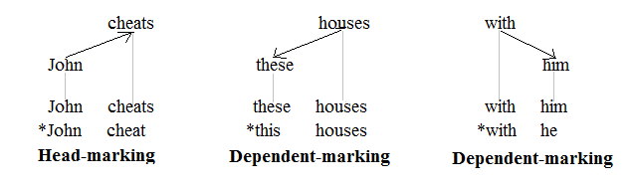
Heads and dependents are identified by the actual hierarchy of words, and the concepts of head-marking and dependent-marking are indicated with the arrows.
Subject-verb agreement, shown in the tree on the left, is a case of head-marking because the singular subject John requires the inflectional suffix -s to appear on the finite verb cheats, the head of the clause.
The determiner-noun agreement, shown in the tree in the middle, is a case of dependent-marking because the plural noun houses requires the dependent determiner to appear in its plural form, these, not in its singular form, this.
The preposition-pronoun agreement of case government, shown in the tree on the right, is also an instance of dependent-marking because the head preposition with requires the dependent pronoun to appear in its object form, him, not in its subject form, he.

Slide 24
There may be other minor mechanisms of indicating ‘who is doing X to whom’ in the languages of the world - e.g. relator nouns and possessive adjectives.
But, apart from the basic word order at the clausal level, case marking is the major means of expressing ‘who is doing X to whom’.

Slide 25
5.2 Alignment typology
In order to further analyze these case markers and the grammatical functions they encode, it is useful to define certain semantic macro-roles, which encompass a multitude of semantic roles across languages and across different semantic verb types.
The term A, S, and O/P
In the study of Case marking of languages, we use the terms A, S, and O/P to mark:
A = stands for agent or, more accurately, the logical subject of the transitive clause.
P = represents patient or, more accurately, the logical object of the transitive clause, and
S = is the sole argument NP - i.e. the logical subject of the intransitive clause.
(Dixon 1994).

Slide 26
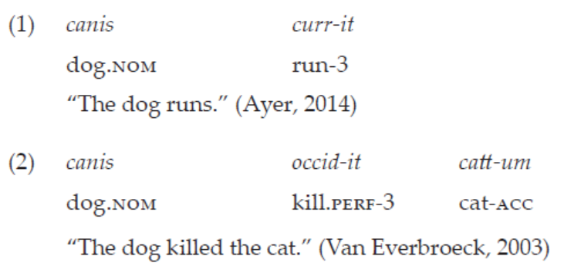
In (1-2) below, examples of an intransitive and transitive sentence from Latin can be seen.
The first, intransitive sentence has only one single argument, the S argument,
whereas the second one has both a subject, the A argument, and an object, the O argument.

Slide 27
Using these macro-roles, one can more easily compare the case marking systems of different languages and see if languages use similar forms for certain arguments with similar functions, resulting in different types of morphosyntactic alignment.

Slide 28
Languages are also divided according to the case system
Case marking is a linguistic phenomenon where languages use specific markers to indicate the grammatical roles of nouns and pronouns in a sentence.
“Case is a system of marking dependent nouns for the type of relationship they bear to their heads.” (Blake 2001:1)
Languages are classified according to how they combined the A, S, and O/P

Slide 29
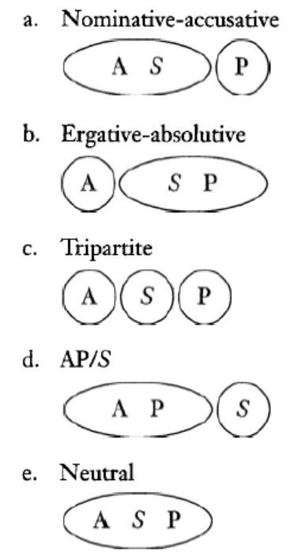
The Alignment types
Five logically possible combinations of A, S and P

Slide 30
i. Nominative-accusative language
The most common alignment pattern is nominative-accusative alignment.
Languages with this type of alignment mark the object of a transitive sentence with a distinct case marker, the accusative case.
The subject of an intransitive subject and that of a transitive sentence have the same form.
This case form, which is usually but not always unmarked, is called nominative.
So, if a language treats Subject of transitive verb and Subject of intransitive verb in the same way, different from the Object of the transitive verb, the language is called Nominative- Accusative language.
Eg. All Dravidian languages, and most Munda languages, Indo-European languages, including Latin,
have nominative-accusative alignment.

Slide 31
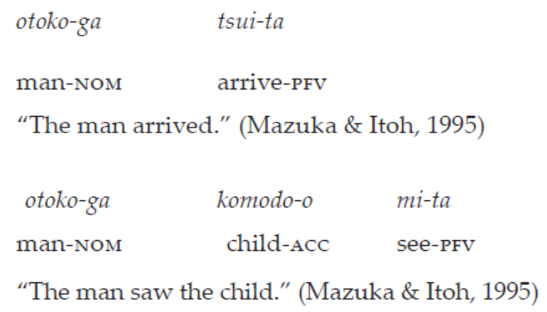
Japanese is an example of this type, as can be seen below, the case marker -ga indicates nominative case, while -o marks accusative case.

Slide 32
Another example: morphological case marking
( ) ram-a swima-kʰwu hwsw-dwŋ-mwn [Bodo in Assam, Northeast India]
Ram-nom dog-acc chase-real-pst
‘Ram chased the dog.’ (- transitive sentence)
( ) ram-a thwi-bai
Ram-nom die-pfv
‘Ram has died.’ (- intransitive sentence)

Slide 33
ii. Ergative-absolutive language
The second most common type of alignment is ergative-absolutive alignment.
In these languages, the intransitive subjects pattern together with transitive objects, while the transitive subjects is different.
The ergative case is used for the subjects of transitive sentences, whereas intransitive subjects and transitive objects are marked with the same, usually unmarked, absolutive case.
So, if a language treats Subject of transitive verb differently from the Object of the transitive verb and Subject of intransitive verb, the language is called Ergative-Absolutive language.
Eg. Indo-Aryan languages, and most Tibeto-Burman languages, Basque

Slide 34
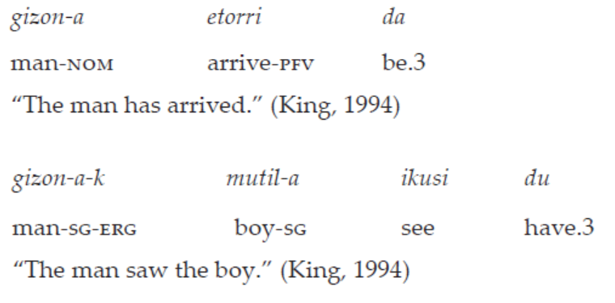
Basque is an example of ergative-absolutive language
Basque is an example of such a language, as can be seen below, which show how transitive subjects are distinguished from zero-marked intransitive subjects and transitive objects through the ergative case marker -ek.

Slide 35
Another ergative-absolutive language
( ) maŋ-in hai-Ø a-ne-e [Thadou in Manipur, Northeast India]
Mang-erg mango-abs 3sg-eat-decl
‘Mang is eating mango.’ (- transitive sentence)
( ) əma-Ø a-kap-e
he/she-abs 3sg-cry-decl
‘He/she is crying.’ (- intransitive sentence)

Slide 36
iii Tripartite system
Languages that mark all three macro-roles with a different case are called tripartite languages or ergative-accusative languages.
Aside from using an ergative case for transitive subjects and an accusative case for transitive objects, tripartite languages also have a distinct case for intransitive subjects.

Slide 37
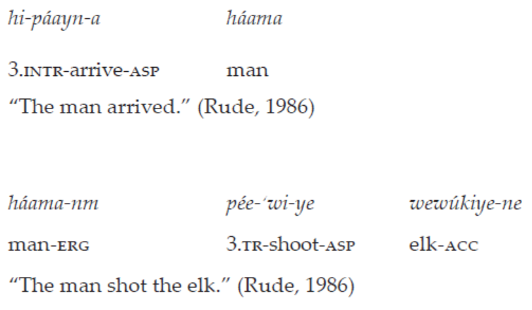
Tripartite languages are fairly uncommon. An example of such a language is Nez Perce.

Slide 38
Another Tripartite is Antekerrepenhe in Central Australia
( ) arengke-le aye-nhe ke-ke [Antekerrepenhe in Central Australia]
dog-erg me-acc bite-pst
‘The dog bit me.’ (- transitive sentence)
( ) arengke-Ø nterre-ke
dog run- pst
‘The dog ran.’ (- intransitive sentence) (Bittner and Hale, 1996:64)

Slide 39
iv The AP/S case
The AP/S case marking system mentioned before is reported to be extremely rare.
Probably it may only exist as a system in transition from one system to another.

Slide 40
v. Neutral case marking system
The last logical possibility is the neutral system.
It is totally irrelevant to case marking per se since there are no case marking distinctions between A, S and P.
Morphologically, they are not marked with case marker.
But since, the subject of transitive verb and subject of intransitive verb behave the same, the patter is considered a Nominative-Accusative case system.
That means Nominative-Accusative language can be either morphologically marked or unmarked for case.
English, Mandarin Chinese is also belongs to this pattern.

Slide 41
We have example form Mandarin Chinese.
(5) zhangsan-Ø mà lisi-Ø le ma [Mandarin Chinese]
Zhangsan scold Lisi crs q
‘Did Zhangsan scold Lisi?’
(6) rén-Ø lái le
person come crs
‘The person has come.’ (Li and Thompson, 1981:20)

Slide 42
English is also case neutral.
This is, in fact, evident in the absence of case marking in English full (i.e. non-pronominal) NPs as has been dis­cussed with respect to (1) and (2).
(1) The girl kicked the boy.
(2) The boy kicked the girl.
(3) John cried
John slept

Slide 43
But pronouns in English has inherent case marking
Subject : Nominative case Object : Accusative case
I, we us
You, you
He, She, It Him, her
They them

Slide 44
More type of Case marking
i. Split Ergative:
In a number of languages both the nominative-accusative and ergative-absolutive case marking systems are in active service.
This type of mixed case marking system is known as the split-ergative system.
The split system can be based on person or tense/aspect.

Slide 45
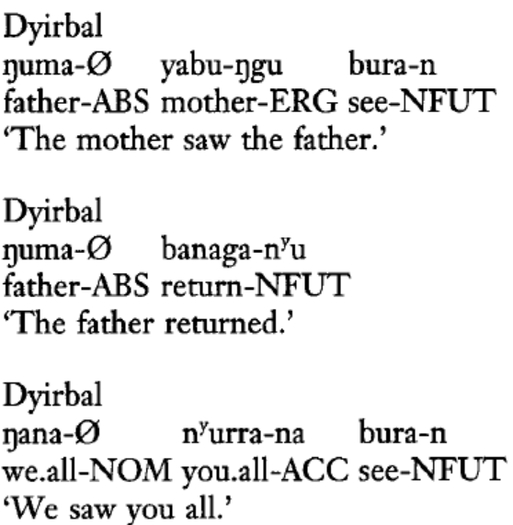
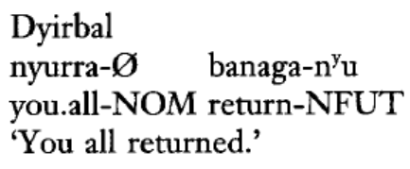
Dyirbal is probably the best known language person based split.
Consider the following data from the Australian Aboriginal language (Dixon 1994: 10, 14).

Slide 46
Tense/ Aspect split
A significant property of the ergative construction, which fits into typological patterns observed in all three surveyed Indo-Iranian languages, is the tense/aspect split.
It is a typological universal that if the ergative is restricted to some tense(s) or aspect(s),
ergative constructions occur in the past tense or perfective aspect, while there is nominative construction
in the remaining tense(s).
Many other Indo-Aryan languages show this tense/aspect/mood type of split.
Some examples of this type of splits are seen in Hindi, Kashmiri, Gujarati, etc.

Slide 47
Another Split Ergative language is : Hindi
examples from Hindi/Urdu are (Kachru 1966: 42):
(1a) laķkā Kitāb paķh-tā hai (transitive sentence)
boy.M.NOM book.F read- IMPERF.M.SG be.3SG. PRES
“The/A boy reads the book.”
(1b) laķkā-nē Kitāb paķh-ī
boy.M-ERG book.F read- PERF.F.SG
“The/A boy read the book.” (past perfective)
(2a) laķkā ĵā-tā hai (Intransitive sentence)
boy.M.NOM go-IMPERF.M.SG be.3SG.PRES
“The boy goes.”
(2b) laķkā ga-yā
boy.M.NOM go-PERF.M.SG
“The boy went.”

Slide 48
Another Split Ergative language is : Hindi
examples from Hindi/Urdu are (Kachru 1966: 42):
(1a) laķkā Kitāb paķh-tā hai (transitive sentence)
boy.M.NOM book.F read- IMPERF.M.SG be.3SG. PRES
“The/A boy reads the book.”
(1b) laķkā-nē Kitāb paķh-ī
boy.M-ERG book.F read- PERF.F.SG
“The/A boy read the book.” (past perfective)
(2a) laķkā ĵā-tā hai (Intransitive sentence)
boy.M.NOM go-IMPERF.M.SG be.3SG.PRES
“The boy goes.”
(2b) laķkā ga-yā
boy.M.NOM go-PERF.M.SG
“The boy went.”

Slide 49
Mona-ne is kitaab-ko parh-aa thaa
Mona.f-erg this.obl book.f-acc read-pfv.msg be.pst.msg
‘Mona had read this book.’

Slide 50
Hindi shows variation in the case marking of transitive objects (DOM).
Hindi requires extensive (obligatory) case-marking for human referring objects as personal pronouns and proper nouns, while it is generally optional with inanimates.
these system requires reference both to degree of animacy and of definiteness.
Hindi restricted to an upper segment of the product of the animacy (1a) and definiteness (2) scales
animacy
(1a) local person>pronoun 3rd>proper noun 3rd [name]>human 3rd>animate 3rd>inanimate 3rd
(16b) agent > patient
(2) definiteness scale:
personal pronoun>proper noun>definite full NP>indefinite specific NP>non-specific indefinite NP

Slide 51
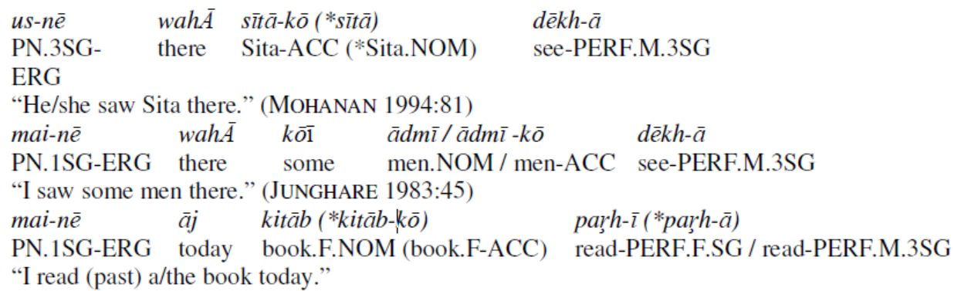
Hindi
a)
b)
c)
However, Hindi does not show difference in the ergative system.
The perfect subject is morphologically marked with the ergative postpositional clitic -nē in all persons and numbers (1st, 2nd and 3rd person pronouns), without any person split ().

Slide 52
5.3 Case and Agreement
We shall see examples of how case determines agreement or how case and agreement are related in languages.

Slide 53
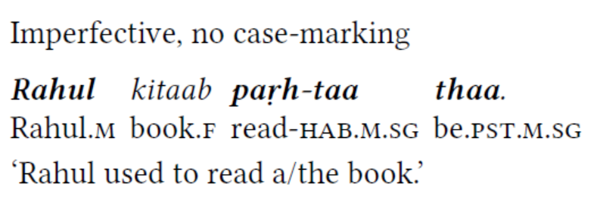
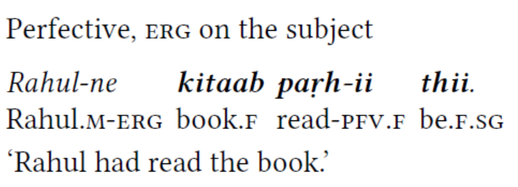
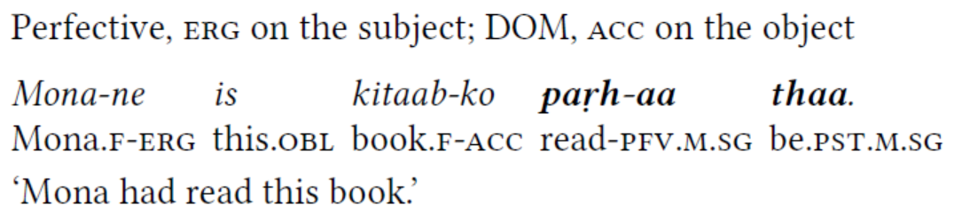
Case-marking and agreement in Hindi (Bhatt 2005: 759, 768)
a)
b)
c)

Slide 54
To summarize case and agreement in Hindi
We have seen case-marking and agreement in Hindi.
In Hindi, we saw that case determines agreement on the verb.
We saw that the highest morphologically unmarked argument triggers agreement with the verb in Hindi.
In other words, the verb agrees with the highest morphologically unmarked argument.
We saw also that the morphological case blocks agreement pattern.
When all arguments are case-marked, the verb shows default agreement (m.sg).

Slide 55
Case and agreement in some Indian languages
We shall look at some other language, apart from Hindi.

Slide 56
We shall loot at Nepali and Marathi language

Slide 57
Nepali
Nepali is also an Indo-Aryan language native to the Himalayas region of South Asia.
It is spoken in India and Nepal.
It is one of the 22 Scheduled Languages as per the Eighth Schedule to the Constitution of India.

Slide 58
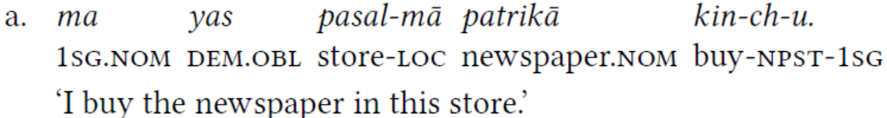
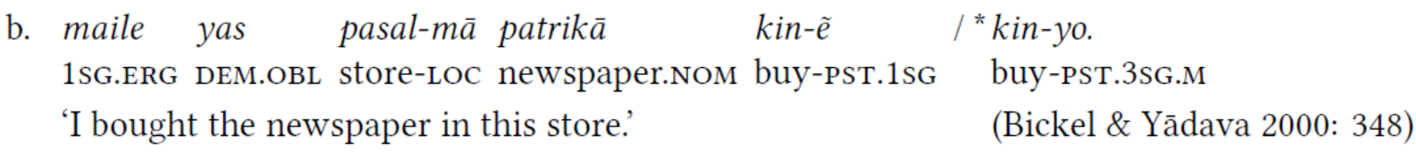
The case and agreement situation in Nepali is different.
While the language is also split-ergative, it differs from Hindi in that agreement is controlled by the highest ergative or unmarked argument.
(1)
In (1a), the subject and the object are both morphologically unmarked the verb agrees with the subject
In (1b), the subject is erg, the object is morphologically unmarked the verb still agrees with the subject

Slide 59
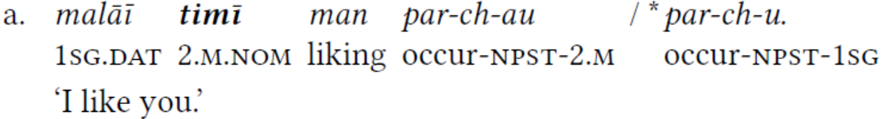
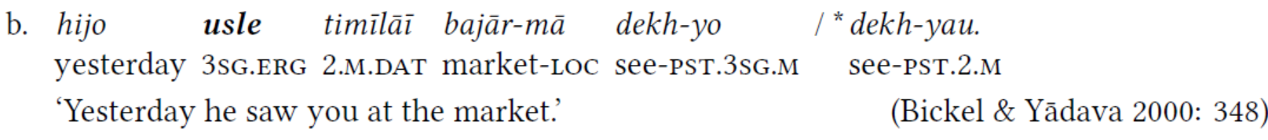
The following examples show that dative (dat) does not trigger agreement in Nepali either.
(2)
In Nepali, the verb agrees with the highest subject, whether it is an intransitive subject (S) or a transitive subject (A).

Slide 60
In Case-marking and agreement in Nepali, we can say that,
The highest morphologically unmarked argument or ergative argument triggers agreement.
The difference between Nepali and Hindi is that Nepali allows the verb to agree with an argument in ergative, whereas Hindi does not.
Crucially, Nepali nevertheless allows the verb to agree with an unmarked argument as well, as shown in (1a).

Slide 61
Marathi
Marathi, at first glance is like Hindi.
Marathi is also an example of split ergative system.

Slide 62
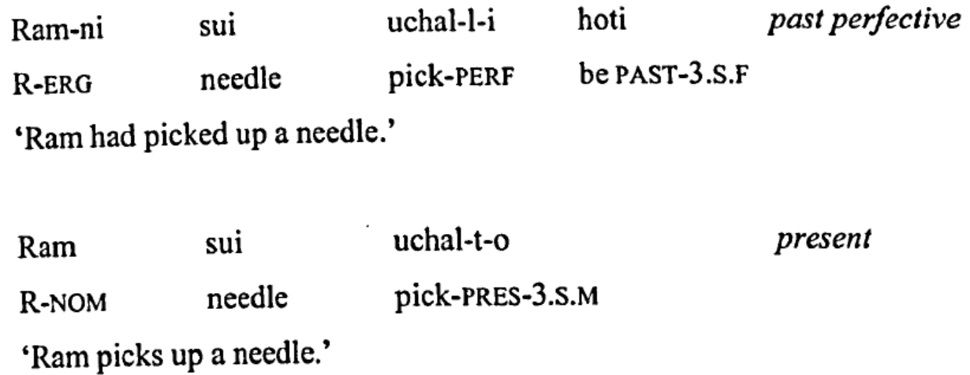
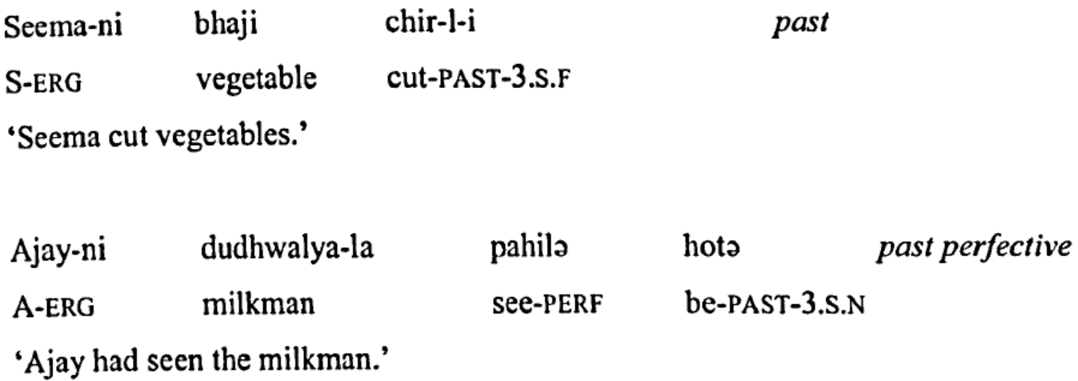
Marathi

Slide 63
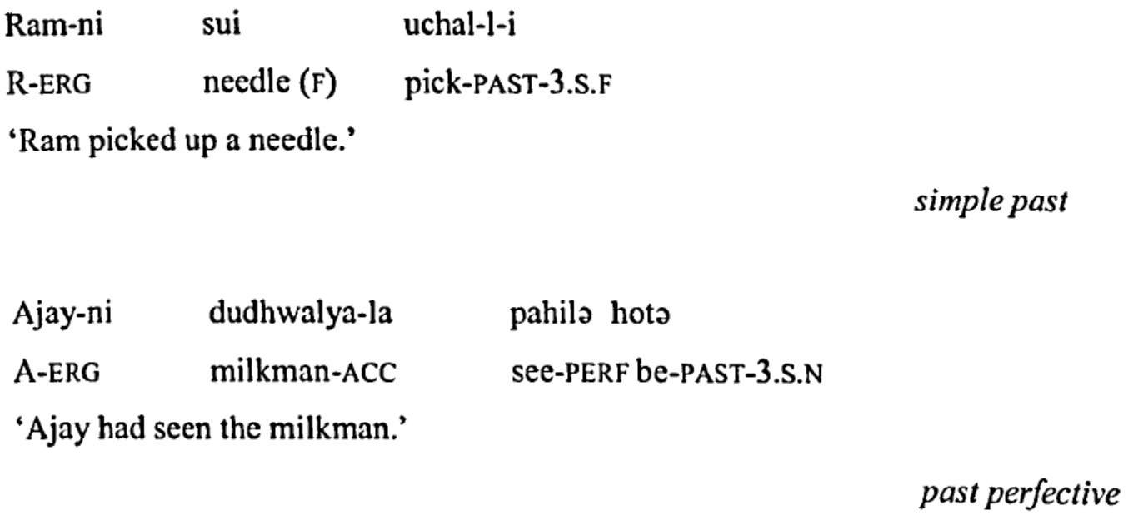
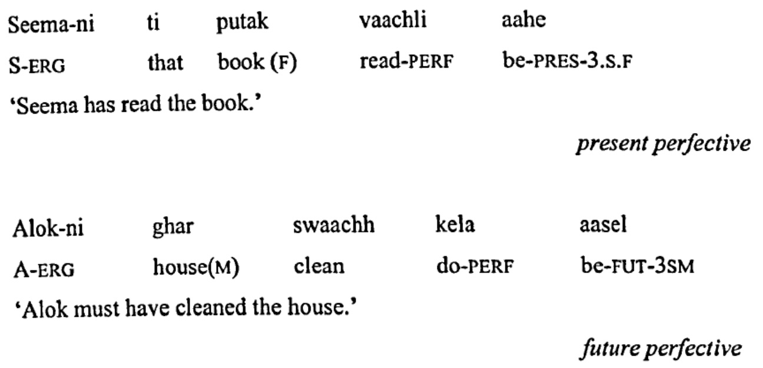
Marathi

Slide 64
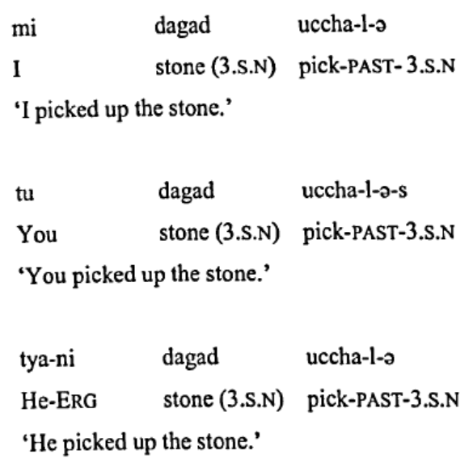
Interestingly, in Marathi, first and second personal pronouns have no overt -ni marking for the ergative case.
The overt -ni marking surfaces only on the third personal pronouns and proper nouns.
Notes:
If this is the case then how do we know for sure that the subjects in (a) and b) are ergative, and not nominative?
The answer to this lies in the fact that in all of the above examples (a - c ) the verb does not agree with the subject NP.
Instead, it agrees with the object.
This suggests that these are covertly ergative marked NPs.
If they were nominative NPs then one would expect them to trigger agreement on the verb, which is clearly not the case.

Slide 65
In terms of case and agreement in Marathi, when the subject is ergative, the verb agrees with the unmarked argument instead.
But there is an additional quirk in Marathi:
1st and 2nd person pronouns never take an ergative suffix.
• This happens even in the perfective.

Slide 66
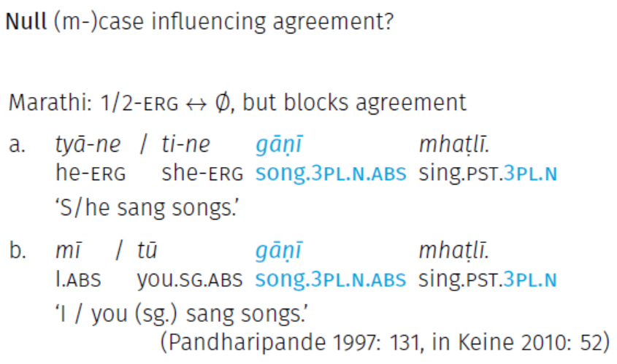
So, what does the verb agree with when the subject is 1st or 2nd person?
See the examples above and also below:

Slide 67
It turns out 1st and 2nd person subjects cannot agree with the verb even though we do not see ergative marker.
What’s going on? On the one hand — morphologically — there is no erg here,
on the other hand — syntactically — there does seem to be something.
If this is the case then how do we know for sure that the subjects are ergative, and not nominative?
The answer to this lies in the fact that in all of the above examples the verb does not agree with the subject NP.
Instead, it agrees with the object.
This suggests that these are covertly ergative marked NPs.
If they were nominative NPs then one would expect them to trigger agreement on the verb, which is clearly not the case.

Slide 68
To sum up
In Hindi, only unmarked case, i.e. abs/nom triggers agreement
In Nepali, erg and abs/nom trigger agreement, but dat does not
Hindi and Nepali (in the perfective) have erg-abs case alignment
But they differ in their agreement pattern
– In Hindi, agreement is erg-abs as well
– In Nepali, agreement is nom-acc
In Hindi, ergative case blocks agreement with the verb.
In Nepali, dative case does not trigger agreement with the verb.
In Marathi also ergative blocks agreement with the verb.
Marathi differs from Hindi and Nepali in how the spell-out of this Case is determined.

Slide 69
References
András Bárány (2017): Morphological case and agreement
https://andras.barany.at/egg2017/08-03-m-case.pdf
Bhatt, Rajesh. 2005. Long distance agreement in Hindi-Urdu. Natural Language & Linguistic Theory 23(4).
757–807.
Claassen, S. A. (2019). Typology of grammatical relations: Explanations in the typology of grammatical relations and alignment systems. RU: ts Student Linguistics Journal, 1(1), 12-22.
Croft, William. 2003. Typology and universals (second edition). Cambridge: Cambridge
University Press.
Dixon, R. M. W. 1994. Ergativity. Cambridge: Cambridge University Press.
Nayudu, A. (2008). Issues in the syntax of Marathi: a minimalist approach. Durham theses, Durham University.
Song, Jae Jung. 2001. Linguistic typology: morphology and syntax. Harlow: Longman.
Whaley, Lindsay J. 1996. Introduction to typology: the unity and diversity of language. London: Sage.

